Slide 1
Why to learn Python?
By Hemlata Kohin

Slide 2
How to Login to the Lab System
Press Ctrl + Alt + Del
Press OK
Username- Upbound
Password- class89ic

Slide 3
Why Learn Python?
Easy to learn
High Level Language
https://www.computerscience.gcse.guru/theory/high-low-level-languages
Gateway to other difficult languages
Python has a simple syntax
Well-furnished standard library and many external libraries
Python is a powerful language, Portable
Salary is great
https://www.glassdoor.com/Salary/IT-People-Salaries-E274233.htm

Slide 4
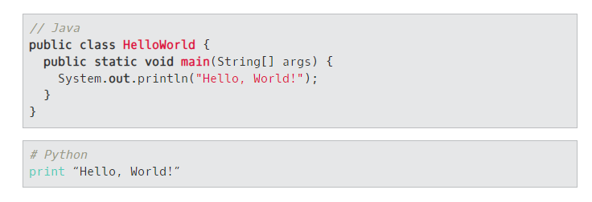
Python Vs Other Languages

Slide 5

What is Python?
Python is an example of a high-level language
Difference between High & Low level languages (machine languages or assembly languages)
Use python to instruct computer to do certain computation for us.
What is a program. (Set of Algorithm)
Two kinds of programs process high-level languages into low-level languages: interpreters and compilers.

Slide 6
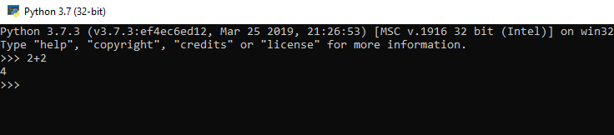
What is Python?
They are first compiled into a lower level language, called byte code.
And then interpreted by a program called a virtual machine.
There are two ways to use the Python interpreter: shell mode and script mode. In shell mode, you type Python expressions into the Python shell, and the interpreter immediately shows the result.
Example of Shell Mode. >>> is called a prompt.

Slide 7
Script Mode
Working directly in the interpreter is convenient for testing short bits of code.
Think of it as scratch paper used to help you work out problems.
Anything longer than a few lines should be put into a script.
http://repl.it/languages/python3
https://www.onlinegdb.com/online_python_interpreter
https://github.com/HKohin (To Access the slides)

Slide 8
What is a Program?
A program is a sequence of instructions that specifies how to perform a computation.
Programming languages are formal languages that have been designed to express computations.
Show an example of Hello World.
Type a program writing ‘This is my first python program’
Did you like programming?

Slide 9
Example programs
Print 3 different statements of your choice.
Make a triangle

Slide 10
Home Work
Open a Github account
Hkohin1@umbc.edu

Slide 11
Type of Errors
Syntax: Syntax refers to the structure of a program and the rules about that structure.
Runtime: The second type of error is a runtime error, so called because the error does not appear until you run the program.
Semantic Error: When the logic of the program goes wrong which means the program will run successfully but it will produce the desired output.
Debugging: The process of finding out the errors is called debugging.

